Slide 1
Proposal Meeting
Prerna Anand
Deeksha Tewari
Hiranya Maharaja
John Adrian Ambrad

Slide 2
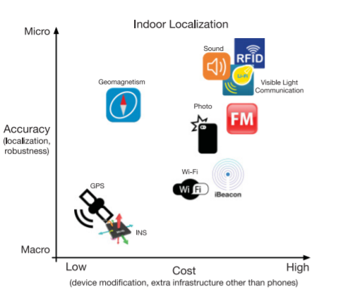
Introduction
Project Goal
The goal of this project is to create a machine learning model that accurately predicts the location of a static object in a specified environment, based on the Wifi signal strength (RSS) received by it.
Accuracy vs Cost [1]
Notes:
Today my team and I are going to go over our capstone project proposal on Indoor localization using physics based ML model.
The idea behind this project was to fill the gap in the industry that there is not an accurate and cost effective way to find the location of an object in an indoor space.
We are going to attempt to fill this gap (goal)

Slide 3
SYSTEM CONTEXT DIAGRAM
Raytracer simulation data
Bahen 8th Floor Map
Database of RSS strength vs positions
Machine Learning Model
Data Cleanup and Processing
(x,y) location of objects based on testing data
Raspberry Pi #2 (Receiver)
Raspberry Pi #1
(transmitter)
WiFi Signal (2.4GHz)
Notes:
(1min): Cover what’s in scope and what’s not in scope
Our System Context Diagram illustrates the basic inputs and outputs to our solution, while also clarifying what the scope of our project is.
Compared to other solutions, we are going to avoid using complicated hardware setups to achieve cost effectiveness. We are utilising Wifi technology as compared to other technologies due to it’s ubiquitousness and long range. We will augment the data we collect with the raspberry pis with the provided raytracer software to perform simulations on the data.
Also because localisation is an infrastructure depent problem, we are only focusing on producing an algorithm for the Bahen 8th floor.
Now we will be discussing the project milestones.

Slide 4
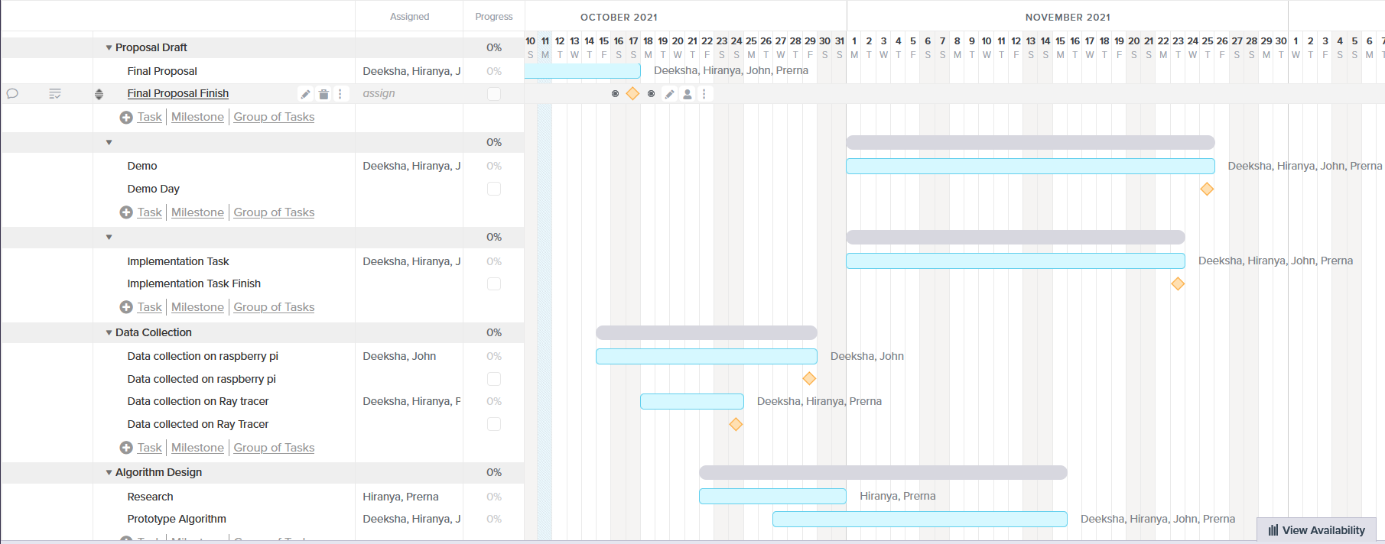
Project Milestones
Notes:
We’ve broken this project down into its major tasks and milestones for the next two months. Data collection will begin within the latter half of october. Our plan is to have both the ray tracer and raspberry pi’s up and running and collecting data for the rest of the month of october in order to gather a large dataset. We also plan to begin research on different types of algorithms As we have 4 members in our group we believe we can in parallelize this with the data gathering. We hope to begin writing parts of the code for a basic algorithm by the last week of october after having done some research and collected some amount of samples that we can examine. From there we hope to focus our efforts on designing a prototype algorithm and have a basic version at least two weeks before the demo in order give us space and time to fine tune the algorithm.

Slide 5
Feasibility
Skills/Resources Needed:
Understanding the current project position
Raspberry Pi + Ray Tracer
Access to Bahen
Risks:
Incompatible ray tracer and raspberry pi data
Possible adaptation: augmenting raspberry pi dataset
Having too many possible models
Possible adaptation: prior research + concurrent coding
COVID-19
Possible adaptation: switch to ray tracer for data collection

Slide 6
References
HE, S. and G. SHIN, K., 2017. Geomagnetism for Smartphone-Based Indoor Localization: Challenges, Advances, and Comparisons. [online] Dl.acm.org. Available at: <https://dl.acm.org/doi/pdf/10.1145/3139222> [Accessed 12 October 2021].

